Slide 1
Lending Club Case Study SUBMISSION
Name: Sandeep Singh

Slide 2
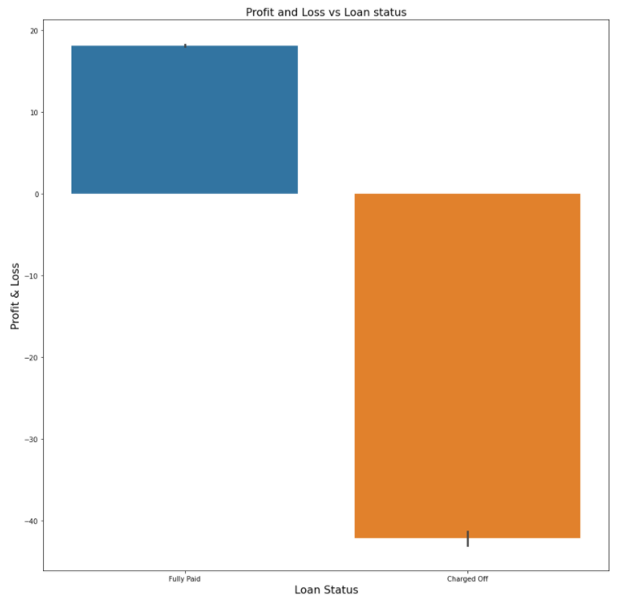
In this bar plot of Profit and Loss vs Loan Status, the banks are in profit of 19% when the loans are fully paid
whereas the banks are in
loss of 41% due to Charged off
loans

Slide 3
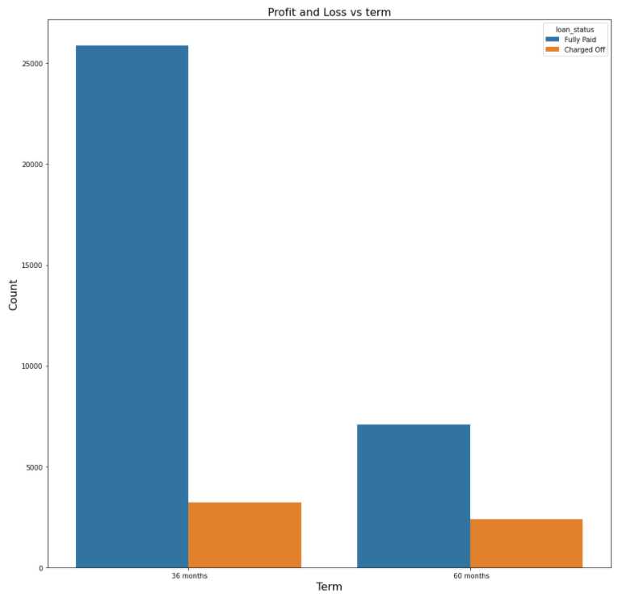
In this bar graph of Profit and Loss vs Term of payment, the chances of loans being fully paid is much higher for term of payment 36 months compared to 60 months
The difference of fully paid and charged off for the two tenure period is much higher for 36 months compared to 60 months

Slide 4
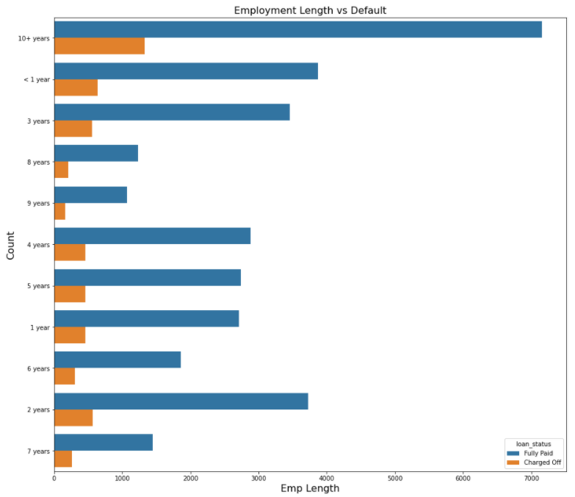
While analyzing the length of employment for loan status, we can see from the graph that people with more than 10+ year of employment have high chances of full payment of loan
From the same graph we see that the applicant of loan with 9 years of employment have least count of charged off

Slide 5
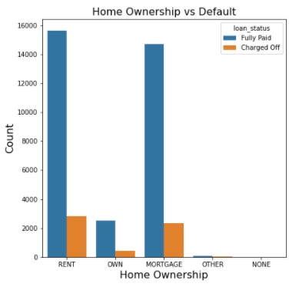
In this bar graph, loans taken for Rent and Mortgage type of home ownership have high chances of loans being fully paid
The cases of loans being charged off is highest for rent closely followed for mortgage. While loans taken for own home, other and none have low chances of being charged off

Slide 6
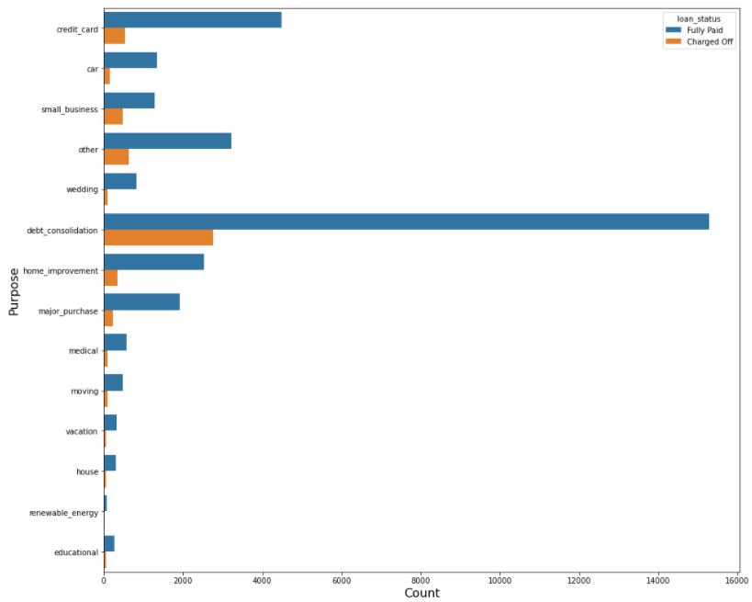
From the horizontal bar graph, we can analyze that the loans are mostly taken for debt consolidation followed by credit card and others
Also, it can be seen that debt consolidation has highest count of charged off followed by others and credit card

Slide 7
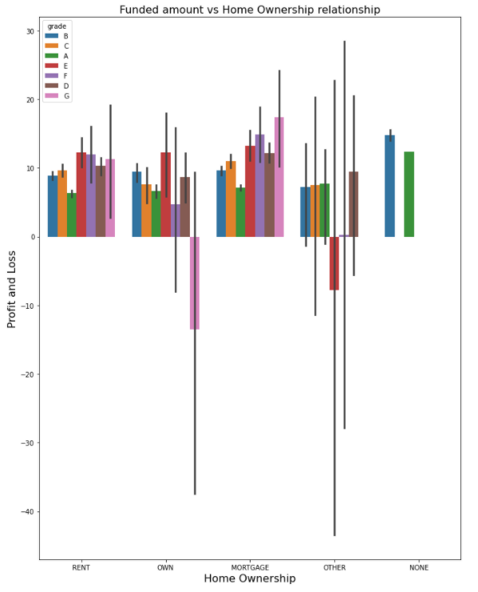
In this graph of Funded amount vs home ownership relationship, mortgage and rent have healthy occurrence of all the Grades with grade E,F and G being top contributors
For relationship type own, we see a high negative value for Grade G and Grade E have a negative value for relationship type other

Slide 8
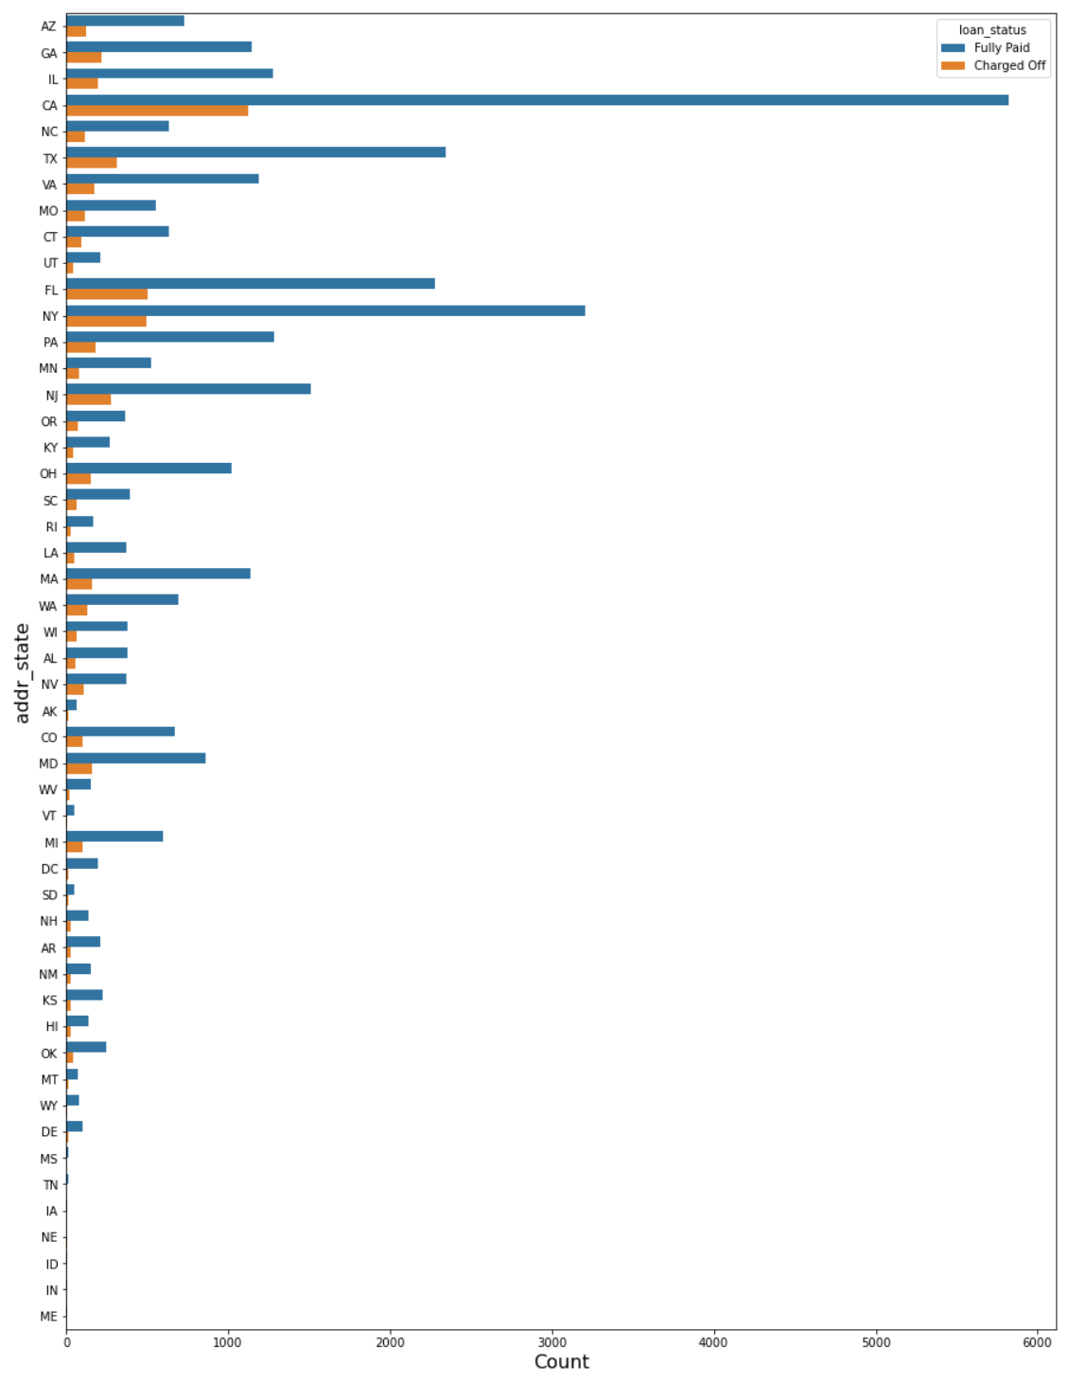
In this plot we see that California state has the maximum loan applicants with highest number of fully paid and charged off as compared to other states.
It is noticed that MS, TN,IA,NE,ID,IN,ME has lowest number of loan applicant

Slide 9
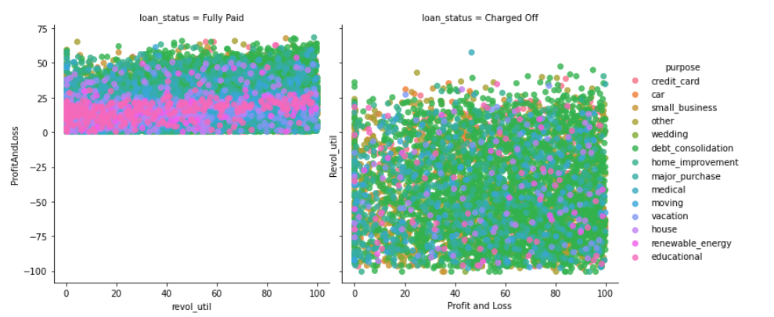
We see the distribution in scatterplot for the profit and loss vs revol_util when the loan status is fully paid vs charged off

Slide 10
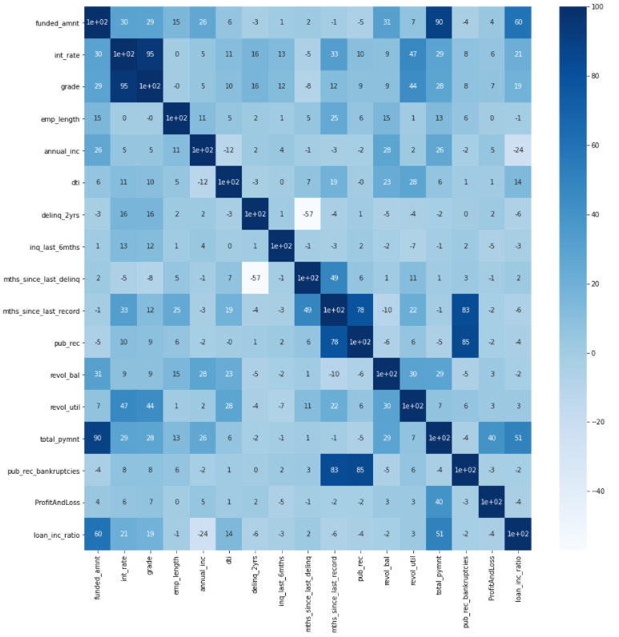

Slide 11
Conclusions
We conclude that the CA state is observed as the maximum opportunity for the banks as it has the maximum number of applicants compared to other states and the fully paid borrowers are also high.
Borrowers having 10+ years of experience are the good borrowers as the number of fully paid applicants are higher
Applicants who stay in rented house or mortgage are the maximum who take loans, so bank can take this as an advantage to grow customers
Applicant having purpose debt_consolidate are the maximum applicant for the loans

